Slide 1



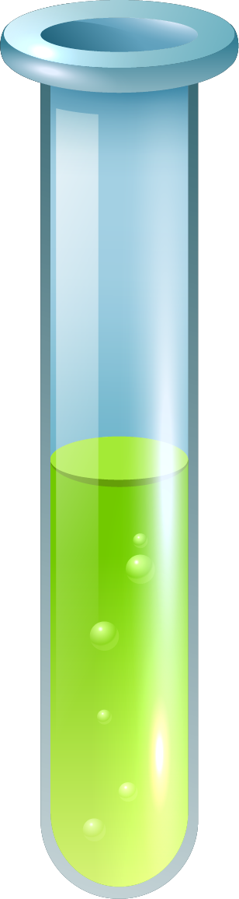
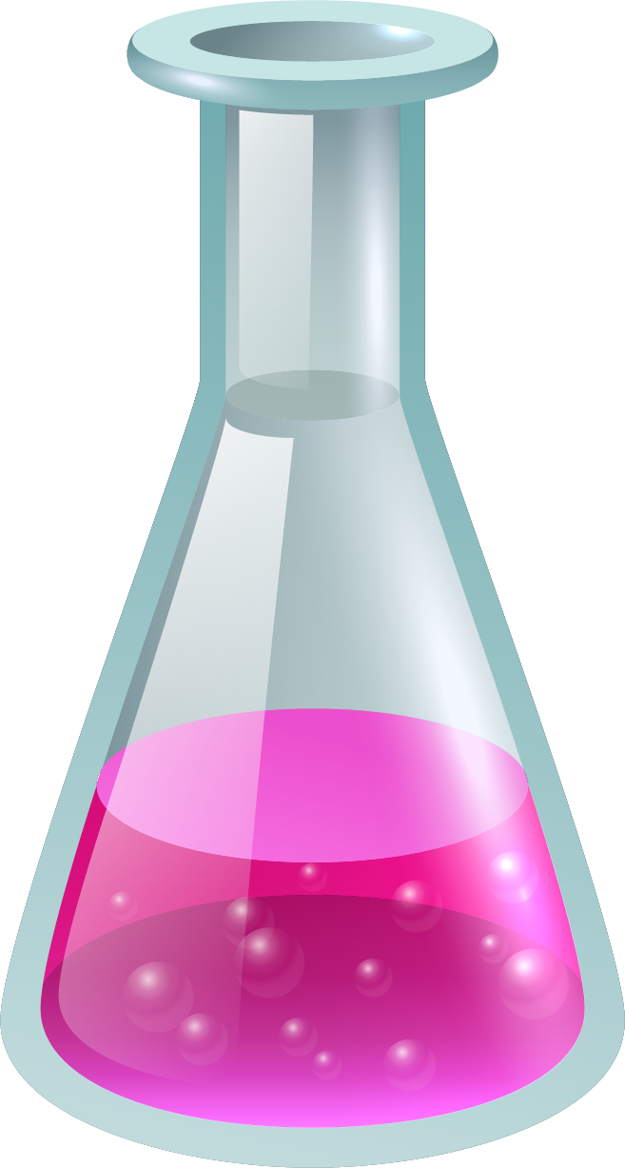
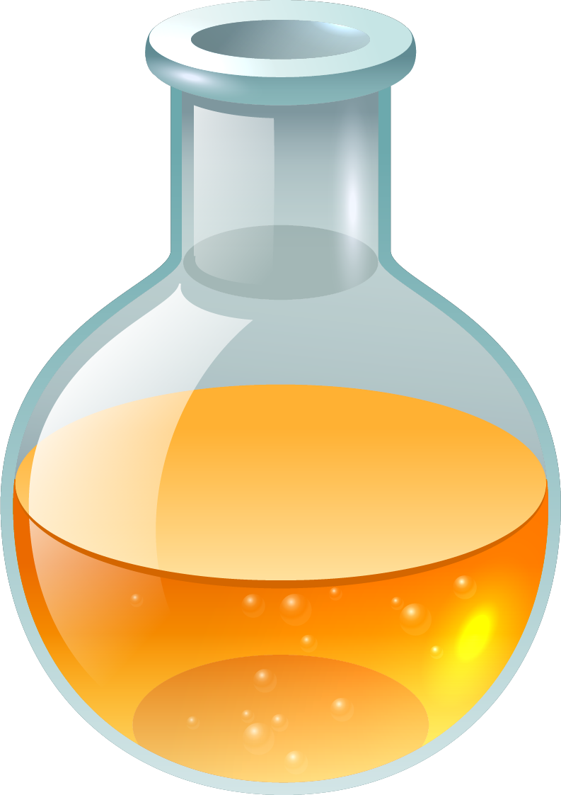
Name of Experiment :
ESTIMATION OF COPPER (Cu) CONTAINED IN A SUPPLIED SOLUTION OF COPPER SALT BY IODOMETRIC METHOD

Slide 2


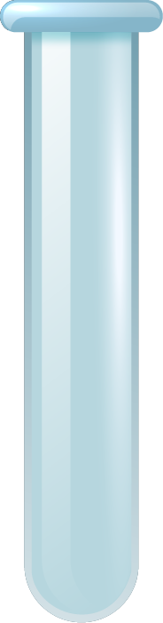
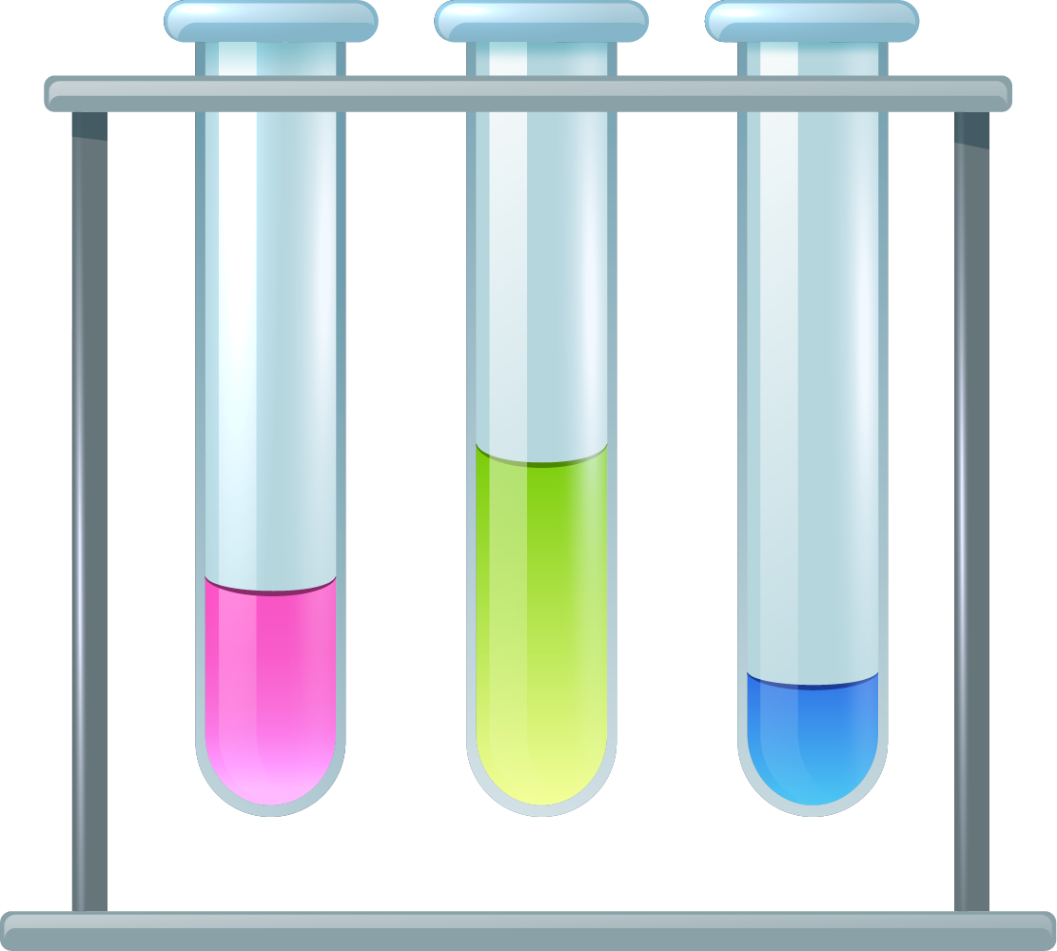

Group Members Course Name : Chemistry
Name | ID
1. MD AHSAMUL HAQUE | 22- 46089-1
2. MD. SHAFIN AHAMED | 22-46274-1
3 AZRA MOKARRAMA KOSHIN | 22- 46545-1
Instructed By : Dr. Abdullah Al Nahid

Slide 3


Table of contents
Experiment Title
Objective
Theory
Apparatus
Required Chemicals
Procedure
Calculation
Result
Discussion.

Slide 4

OBJECTIVE
To determine the amount of Cu⁺² ions in a supplied solution of copper salt by iodometric method.

Slide 5





Theory
K2Cr2O7, classified as a primary standard substance, serves as an oxidizing agent, appearing as an orange solid (molecular weight: 294, gram-equivalent weight: 49) and exhibiting orange coloration in water solution. Na2S2O3.5H2O, designated as a secondary standard substance, functions as a reducing agent, presenting as a white solid (molecular weight: 248, gram-equivalent weight: 248) and displaying colorlessness in water solution. CuSO4.5H2O, an inorganic compound (also known as blue vitriol), acts as an oxidizing agent, displaying a blue color and having a molecular weight of 249.68, and appears blue in water solution. The balanced reactions of CuSO4 in the presence of NH4OH, CH3COOH, and KI (a white solid, a reducing agent) and of Na2S2O3 with I2 are as follows:
1. 2CuSO4 + 4KI = 2K2SO4 + 2CuI ↓ + I2
2. 2Na2S2O3 + I2 = Na2S4O6 + 2NaI

Slide 6
Reaction:
2CuSO₄ + 4KI = 2K₂SO₄ + 2CuI ↓ + I₂
Copper sulfate reacts with potassium iodide to form potassium sulfate, copper iodide, and elemental iodine.
2.2Na₂S₂O₃ + I₂ = Na₂S₄O₆ + 2NaI
Sodium thiosulfate reacts with elemental iodine to produce sodium tetrathionate and sodium iodide.

Slide 7

APPARATUS
Burette (50mL),
pipette (10mL),
conical flask (250mL),
volumetric flask(100mL),
watch glass,
pipette filler,
dropper,
stand and clamp etc.

Slide 8
REQUIRED CHEMICALS
12% KI solution, | Copper salt solution
NaHCO₃ solid | 6M NH₄OH
Conc. HCl acid | Conc. CH₃COOH
Standard K₂Cr₂O₇ solution, | 10% NH₄SCN solution
Na₂S₂O₃ solution | Starch solution

Slide 9
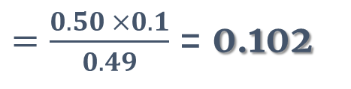
Standardize sodium thiosulphate solution as Expt. No. 5
Table-1: Standardization of supplied Na₂S₂O₃ solution against standard K₂Cr₂O₇ solution by oxidation-reduction titration.
No. of reading | Vol. of K₂Cr₂O₇ (in mL) | Vol. of Na₂S₂O₃ (burette reading) (in mL) |  |  | Mean (in mL)
 |  | Initial | Final | Difference
1 | 10 | 0 | 12.2 | 12.2 | 12.1
2 | 10 | 12.2 | 24.2 | 12
Strength of K₂Cr₂O₇ solution =
$=\frac{0.50 ×0.1}{0.49}$ = 0.102

Slide 10
Procedure
Pipette 10 ml of Copper salt solution
Continued titration until color changed
Added NH4OH & CH3COOH
Copper content in 500 mL calculated
Introduced 10 mL of KI solution
Terminated
Titrated against Na2S2O3 until color changed
Added starch solution
Continued titration until color faded
Added NH4SCN solution

Slide 11
EXPERIMENTAL DATA:
Strength of supplied Na₂S₂O₃ solution (S): V_{thio} x N_{thio} = V_{dichromate} x N_{dichromate}
Table-2: Determination of the amount of copper in a supplied solution of blue vitriol by iodometric method.
No. of reading | Vol. of Copper salt solution (in mL) | Vol. of Na₂S₂O₃ (burette reading) (in mL) |  |  | Mean (in mL) (V)
 |  | Initial | Final | Difference
1 | 10 | 24.2 | 31.1 | 6.9 | 7.3
2 | 10 | 31.1 | 38.6 | 7.5
3 | 10 | 38.6 | 46.1 | 7.5
4 | 10

Slide 12
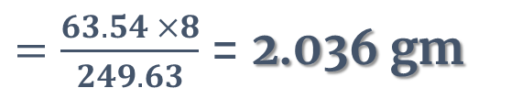
Calculation
2 CuSO₄ ≡ I₂ ≡ 2 Na₂S₂O₃
1 ml 1N Na₂S₂O₃ ≡ 0.06354 gm of Cu²⁺
Amount of copper ions in 10 mL of copper salt solution= 0.06354 × V × S gm
= 0.06354 × 7.3 × 0.0842 = 0.039
Amount of copper ions in 500 mL of copper salt solution = 0.06354 × V × S × 50 gm
= 0.06354 × 7.3 × 0.0842 × 50 = 1.952 gm
Observe value of Cu²⁺ (in 500mL solution) = 1.952 gm
Known value of Cu²⁺ (in 500mL solution)
$=\frac{63.54 ×8}{249.63}$ = 2.036 gm

Slide 13
RESULTS
Amount of copper ions in 500 mL of copper salt solution : 1.952 gm
PERCENTAGE OF ERROR:
= 4.126 %

Slide 14
Discussion :
Precautions taken
Lavatory Aprons must be worn
Burette readings were taken carefully .
never touch any chemicals with bare hands use correct lab techniques
Possible Error :
1 . During volumetric analysis extra one or two drops of K2Cr2O7 may have dropped .
2.A little amount of extra water might have added into the volumetric flask .

Slide 15
Conclusion
In conclusion, the experiment successfully determined the concentration of Cu+2 ions in the provided copper salt solution using the iodometric method. Through redox titration and precise procedural steps, the copper content was accurately estimated. The calculated value was compared with the expected value to evaluate the experiment's accuracy, revealing any margin of error. Overall, the experiment demonstrated the effectiveness of the iodometric method for quantitative analysis of copper ions.

